Slide 1
Explaining trip generation during the COVID-19 pandemic: A psychological perspective
Rifat Sultana Mahin
ID-0424042419

Slide 2
Objective
Investigate how much the students reduced their non-essential trips during the pandemic
Test how, and to what extent, psychological factors could explain such travel behavior

Slide 3
Source of Data
Online Survey: Internet-based survey of the students at Kharazmi University, Tehran, Iran.
Primary data :conducted by the researchers to collect first-hand information directly from the participants
Survey Period: April to June 2020
Participants: A sample of 369 students

Slide 4
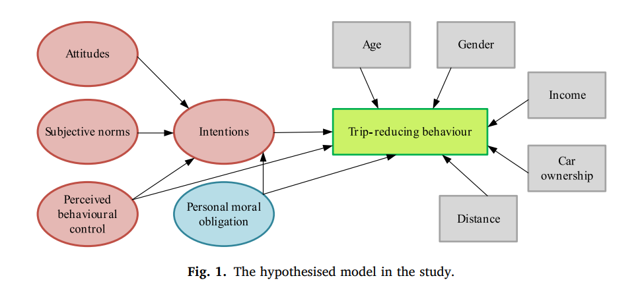
Hypothesized model

Slide 5
Method
Procedure and sample
Questionnaire
Analysis
Results

Slide 6
Key Elements
Survey Method
online survey
socio-demographic questions
psychological constructs
trip frequency
Sampling Technique
Non-probability sampling

Slide 7
Key Elements
Questionnaire Design
Table-1 (Age, Gender, Distance, Car ownership)
Table-2 (Attitude, Subjective norm, Perceived Behavioral Control, Intention, Personal moral norms)
Data Analysis
Structural Equation Modeling (SEM)
Reliability Check

Slide 8
Result
Reduction in Trips:
Average reduction: 60% for non-essential trips.
Women reduced trips more than men.
Psychological Impact:
The Theory of Planned Behavior (TPB) effectively explained trip-reduction behavior.
Perceived Behavioral Control (PBC) was critical.
Personal moral obligations indirectly influenced trip reduction.

Slide 9
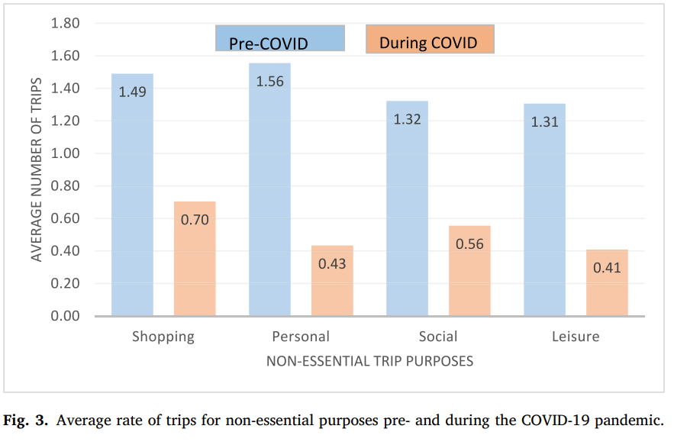
Result
Socio-Demographic Insights:
Gender differences were significant.
Distance to university affected social trips.

Slide 10
Limitations
Self-Reported Data:
Participants' answers may not always be accurate or honest.
Small and Specific Group:
Focused only on students from one university in Iran; results may not apply to everyone.
Limited Timeframe:
Data collected during the first wave of COVID-19; doesn’t reflect later behavior changes.
Young and Educated Participants:
Findings may not represent older or less-educated groups.
Local Challenges:
Lack of online services (e.g., food delivery, internet banking) might have influenced travel behavior.

Slide 11
Suggestion
Activity-Based Models (ABM) for capturing daily activity and trip patterns.
Instead of just counting trips, ABM asks:
Why do people travel?
Where do they go?
How do they travel?
When do they travel?
Bayesian Updating for dynamically modeling psychological and behavioral changes.
Behavior changes dynamically
combine the old knowledge and new data
It’s flexible and improves predictions over time

Slide 12


